Slide 2
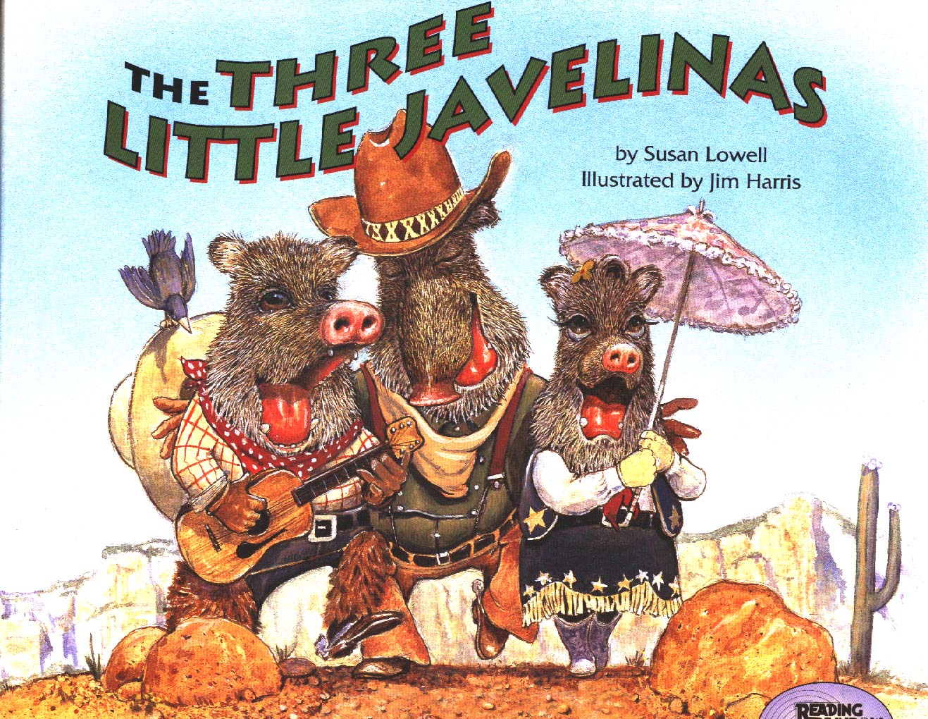
The Three Little Javelinas

Slide 3
wandering
To walk from place to place without a plan
The girl was wandering alone on the empty road.

Slide 4
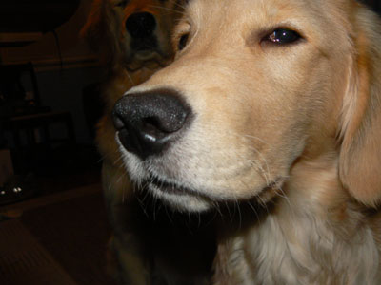
suspicious
Not sure of something or someone
The dog was suspicious of the new cat in his house.

Slide 5
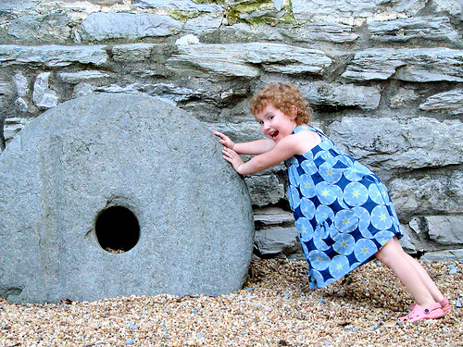
budge
To move a little
The rock would not budge.

Slide 6
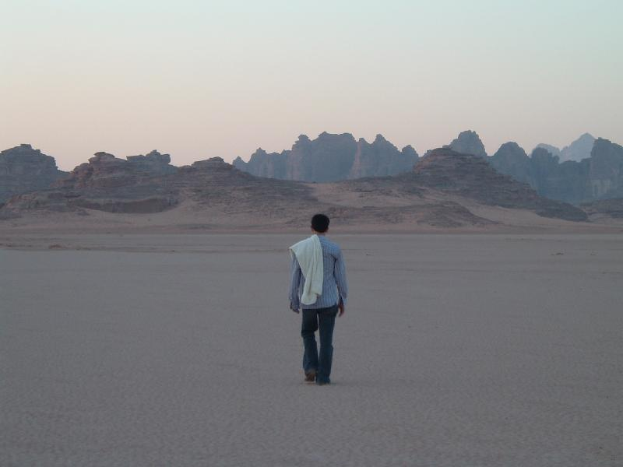
Which goes with wandering?

Slide 7
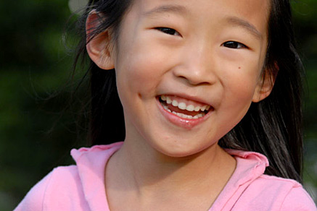
Which goes with suspicious?

Slide 8
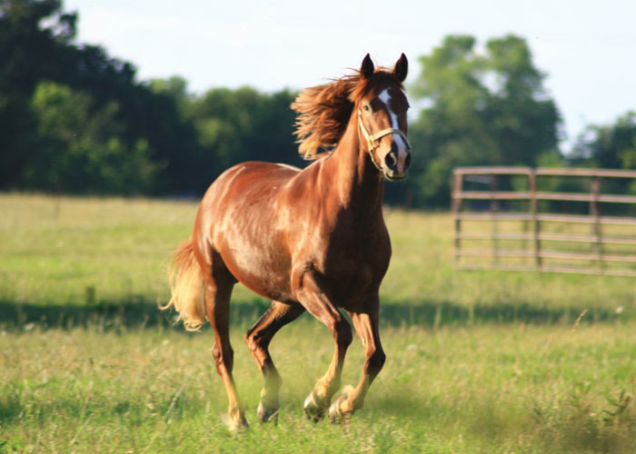
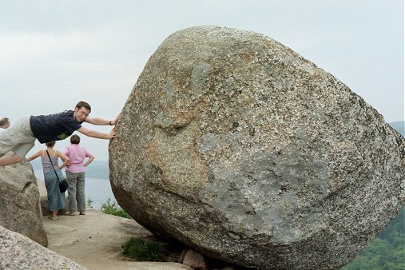
Which goes with budge?

Slide 9
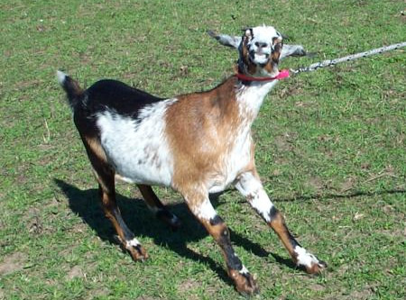
Which word goes with this picture? (wandering, suspicious, budge)

Slide 10
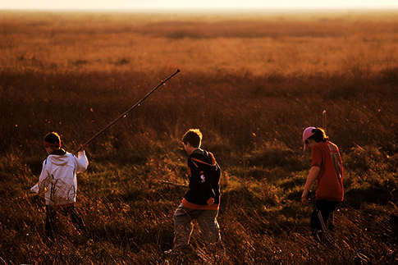
Which word goes with this picture? (wandering, suspicious, budge)

Slide 11
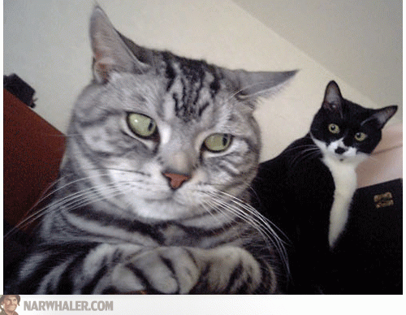
Which word goes with this picture? (wandering, suspicious, budge)

